Slide 1
Activity Examining Packets with Wireshark

Slide 2

what is ?
Wireshark is a network packet analyzer aka – a packet sniffer
It captures packets and makes it possible for the user to examine all parts of that packet, including:
Addressing info
Protocols and ports
Actual data from inside the packet
It is FREE and works well on all operating systems

Slide 3
Activity Goals
Reinforce your understanding of how packets and packet delivery work.
Introduce the basic concepts necessary to using Wireshark

Slide 4
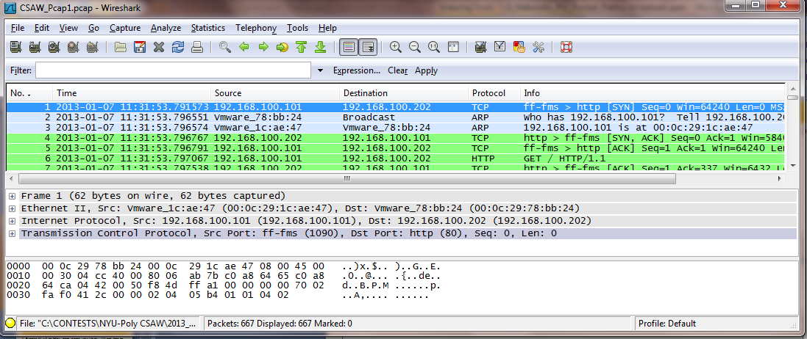
Activity 1
- getting to know who is who
https://drive.google.com/file/d/1TmQOF-OXMPchYyOFz8o0fqmXdVOXqoga/view?usp=sharing
1 Packet List
2 Packet Details
3 Packet Bytes

Slide 5
Activity 1
The Packet List pane gives a chronological list of every packet captured. Includes time, source & destination IP addresses, Protocol and very basic Info
The Packet Details pane gives more specific info about each packet, grouping the info by the layers used. Here we can find MAC addresses, ports, and some text data.
The Packet Bytes pane (aka the Data pane) shows the data that was carried in the packet. The data is shown in hexadecimal (middle) and text (right).

Slide 6
In the Packet List Pane
Find the “connectivity” packets
Source + Destination IP addresses = packet 1
ARP = packets 2 & 3
3-way handshake = packets 12 – 14 (there are many more)

Slide 7
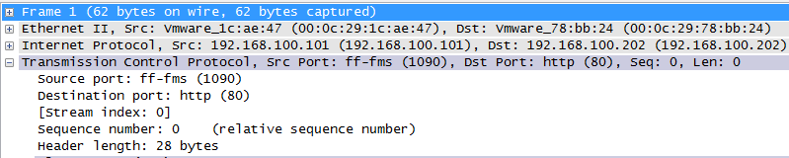
In the Details Pane
identify the following:
Source and destination MAC addresses ?
What kind of protocol is being used and what ports
Notes:
Note that we primarily concentrate on the destination protocol and port. The source port number is usually chosen at random from one of the non-assigned ports, while the destination port is the default one assigned to the protocol being used.

Slide 8

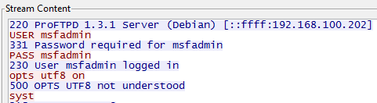
In the Bytes Pane what data can we find?
The confusing way . . . (this is packet #50)
The much easier way . . .
Right click on the first packet – select Follow TCP Stream
Notes:
Note that both ways produce results where you see the user’s login and password. But the Follow TCP Stream is MUCH more legible.
Tip: the items in red = text that the user has typed in.
After using Follow TCP Stream, you must go to the top toolbar and click on CLEAR. Since it was a filter, you will wonder where all the packets went unless you remove the filter.

Slide 9
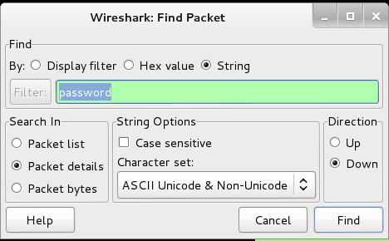
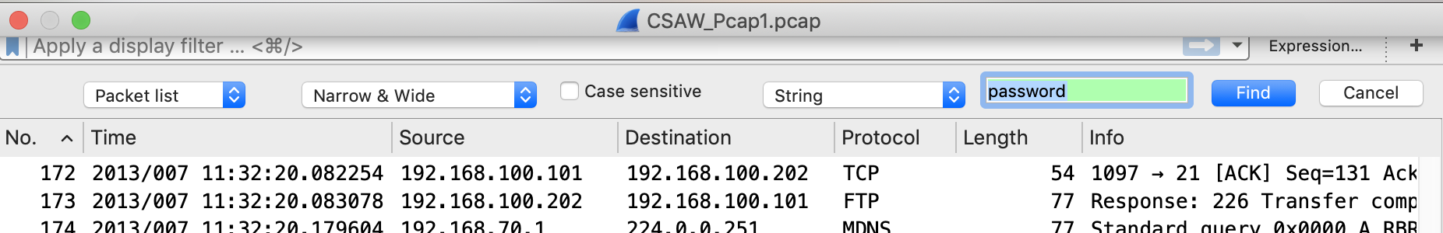
Three other ways to find info in Wireshark
Edit | Find Packet | strings
Check for password or user text strings

Slide 10
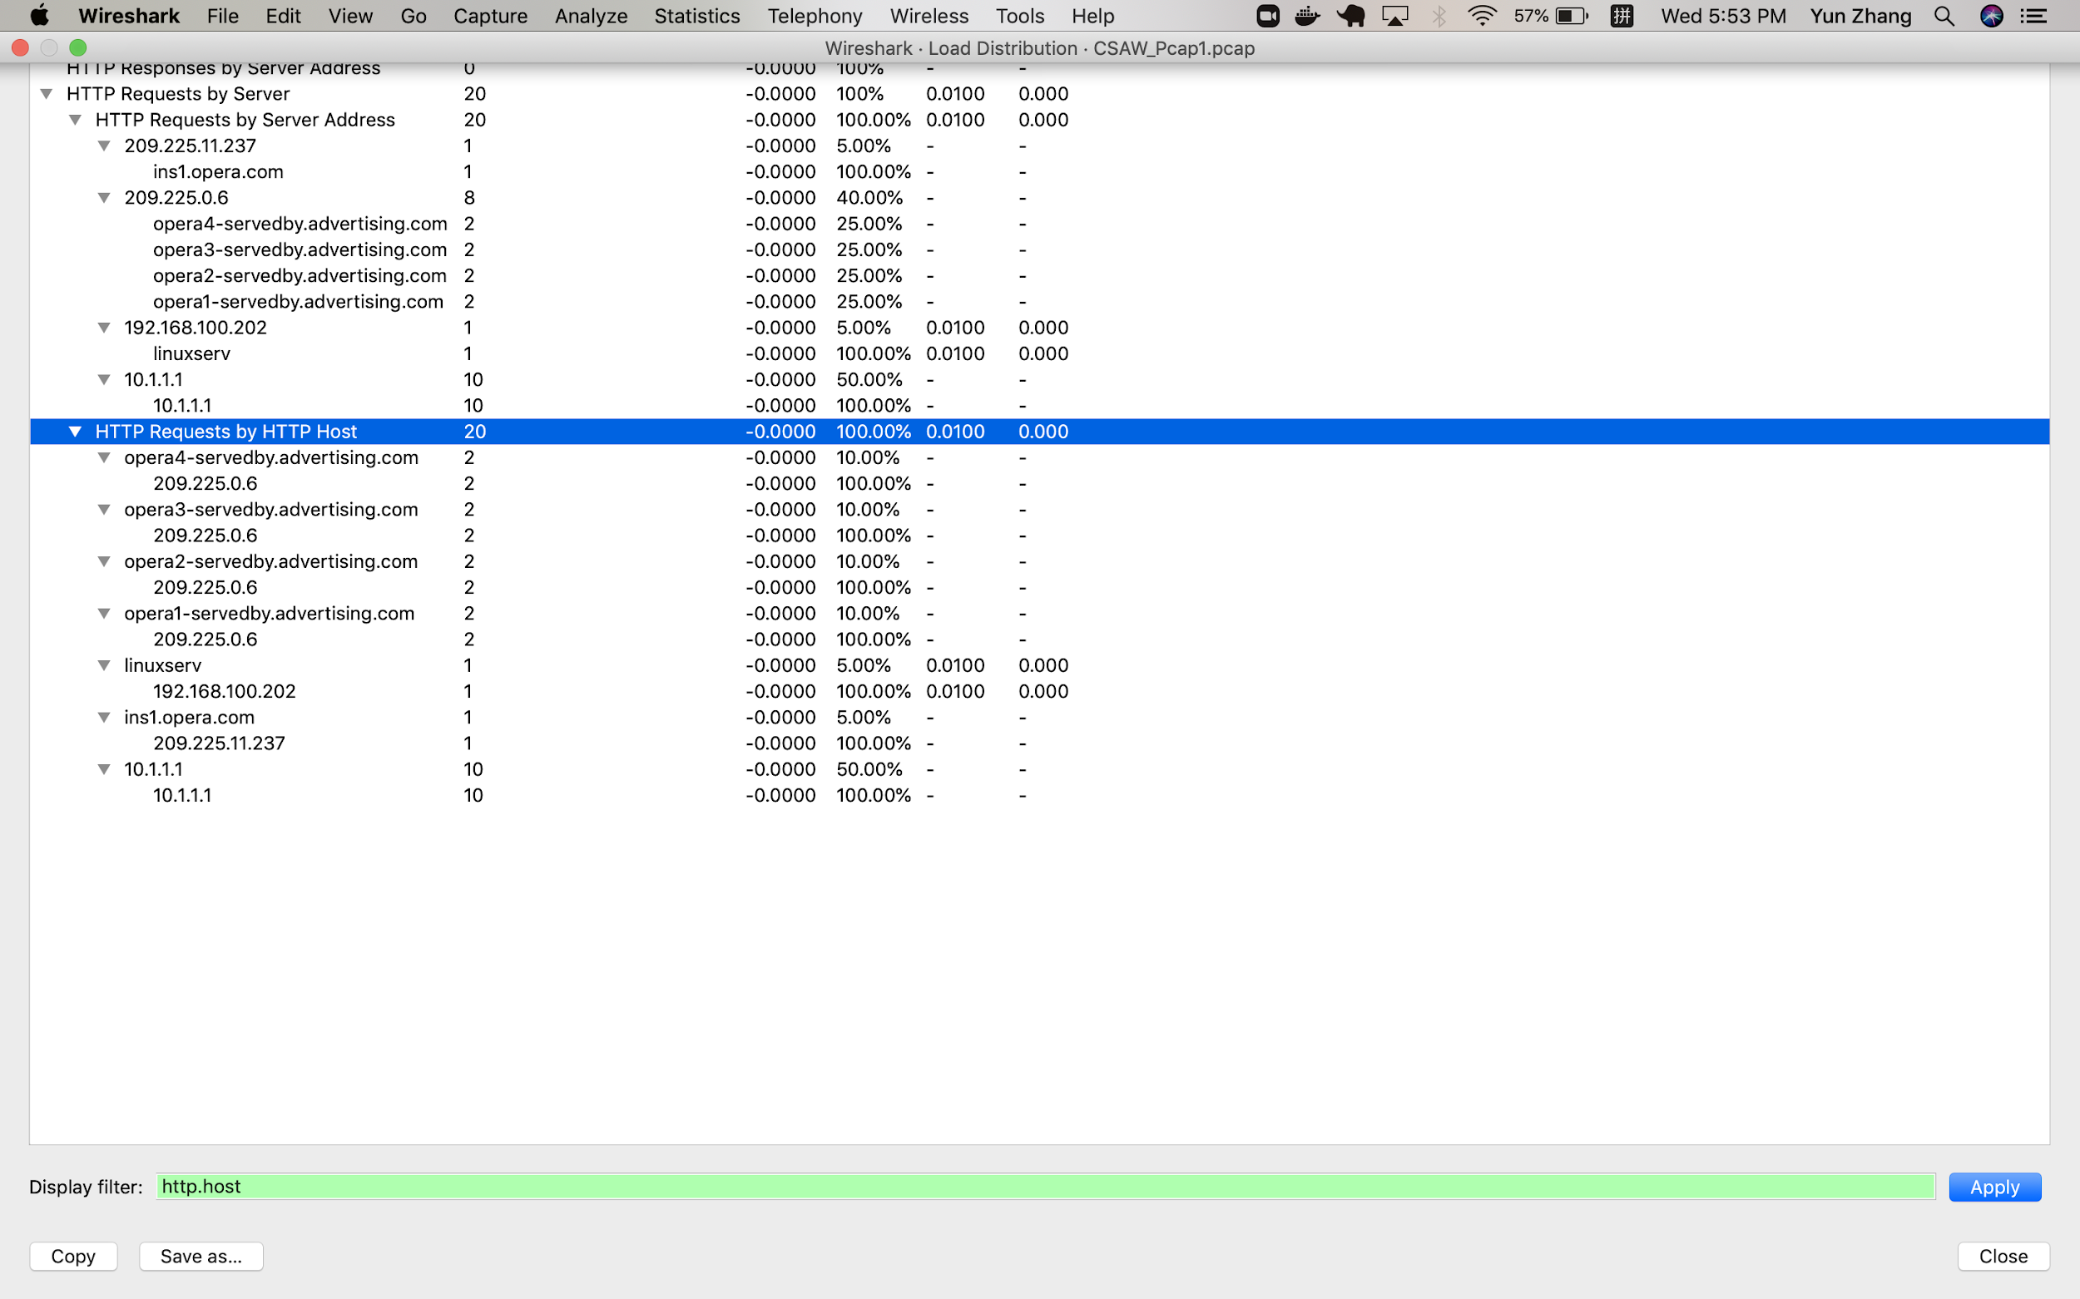
2. Statistics | HTTP | Load Distribution and type http.host
Now look at the "HTTP Requests by HTTP Hosts". This will show you all the HTTP type traffic in this capture.

Slide 11
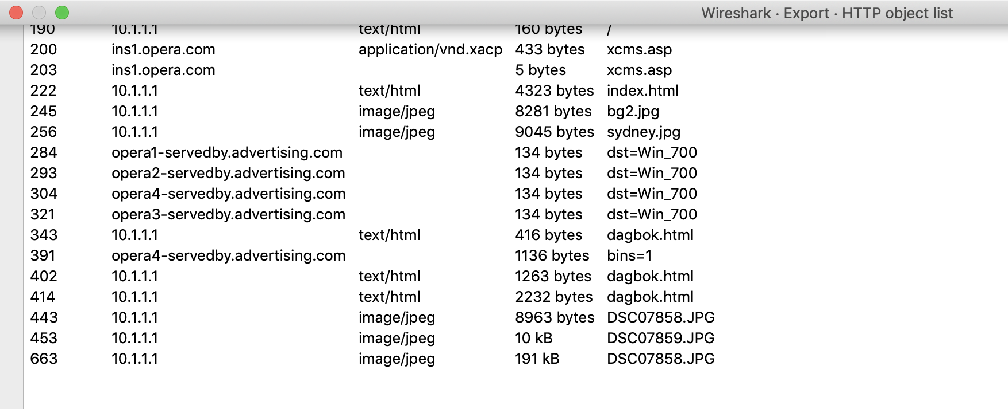
3. File->export->objects->http
Extract objects like pictures or attachments from the HTTP stream

Slide 12
Now let’s sniffe along
Use Pcap2 and Pcap3 files to answer questions on handout
PCAP2: https://drive.google.com/file/d/1scO_Rq5vBmapwE1cpXv1_vKlQT-osD0k/view?usp=sharing
PCAP3:
https://drive.google.com/file/d/1zNBVHLDWOdS5ODfAiuZn0Aav9H_OZGCT/view?usp=sharing

Slide 13
Networks Part 3: Packet Paths + Wireshark
CS4CS 2020
Slides By: Mandy Galante

Slide 14

The Boring Way

Slide 15
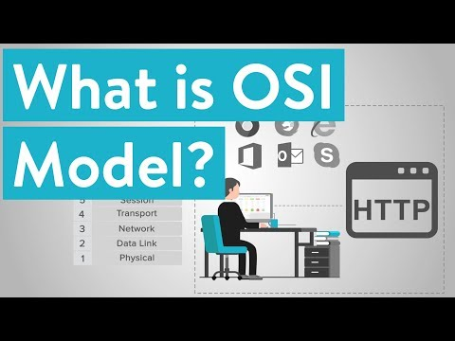
OSI Model (Open System Interconnection)

Slide 16
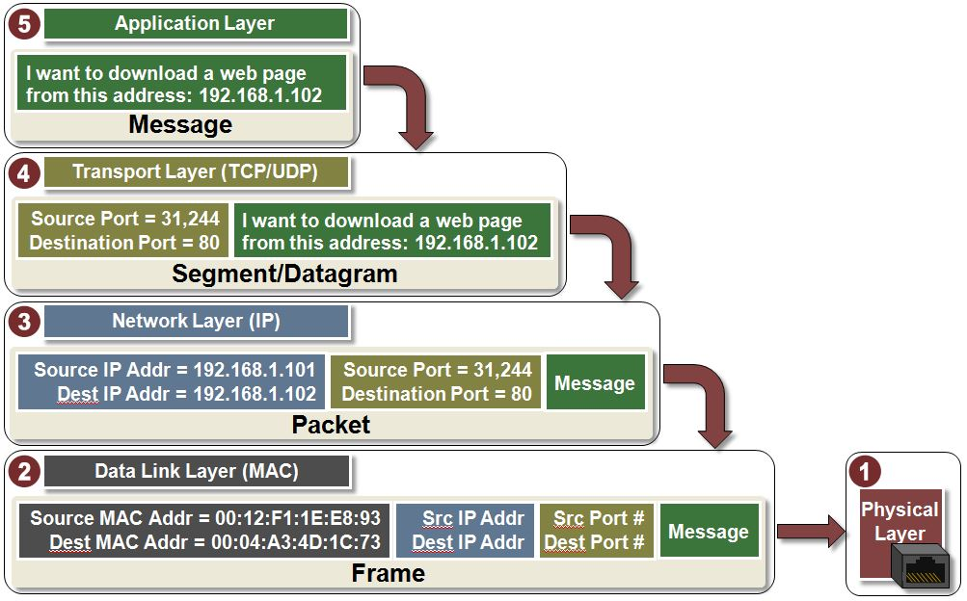
Notes:
https://www.youtube.com/watch?v=VGGmBhARuiY

Slide 17
The Fun Way
https://howdns.works/
Notes:
https://howhttps.works/why-do-we-need-https/
The blue cat is the narrator - the most talking
The white browser
The red gear is OS
Red resolver
The blue root
.Com white igloo and others
Sheriff authoritative server
Target website
Human with glasses
No words narrator

Slide 18
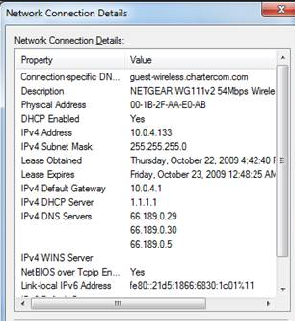
Step One
Your computer is set to get its IP configuration dynamically, so it sends out a DHCP request.
The network DHCP server responds with: - IP address - Subnet mask - Default gateway IP address - DNS server IP address
Notes:
To see your Network Connection details in Windows 7:
Start >Control Panel > Network & Sharing Center > Change Adapter Settings > doubleclick on the Interface (like Local Area Connection or Wireless Network Connection) > click on Details

Slide 19
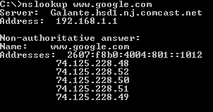
Step Two
Your computer sends a request to the DNS server asking it to provide an IP address for the FQDN www.google.com.
Try this: in a command prompt, type nslookup [ENTER] the answer will tell you who provides your DNS service
Notes:
FQDN = Fully qualified domain name
Com = Top level domain
Google - org

Slide 20
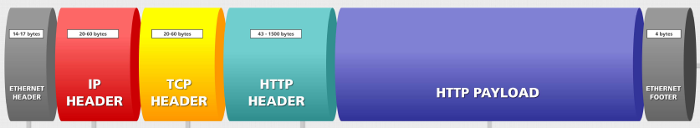
Step 3
Your computer creates a packet that includes:
the source IP address
the destination IP address
the protocol (HTTP)
the destination port number (80)
NOTE: the packet has a LOT more stuff, but this will do for now.
Photo credit:: www.barracudadeals.com/freebies/poster/poster_http_packet.pdf

Slide 21


Step 4
Your PC now needs a MAC address, but it cannot get it from an ARP request because the destination IP address is not in our network. (How do we know?)*
SO . . .your computer uses the MAC address of the default gateway.
Default Gateway
YOU
Source IP address:
192.168.2.34
Source Mac address:
A1:FF:32:5A:EC:AA
Destination IP address:
74.125.228.48
Destination Mac address:
C2:3D:57:80:A0:EE
192.168.2.1 C2:3D:57:80:A0:EE
192.168.2.34 A1:FF:32:5A:EC:AA
74.125.228.48
Notes:
* We can tell the destination address is not in our network because the network portion of the address is different from the network portion of our IP address. Note that our IP address is in a private range and the Google address is in a public range.

Slide 22


Step 5
The default gateway is a router which is configured to have knowledge of other networks near it.
Using a special set of protocols to communicate with other routers, it decides to send your packet to the “closest” router.
The routers keep handing off your packet until it reaches its destination.
YOU
Default Gateway

Slide 23
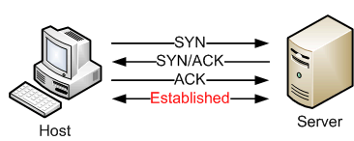




Step 6
HTTP is a connection–oriented protocol so the Google web server and the host PC go through a 3-way handshake to negotiate the TCP connection.
Then the browser starts to access the html page which will result in LOTS of packets being downloaded.
Remember – a browser is a piece of software that follows the html instructions to build the page you see. A website is not just a “document” or “page” – it is an infrastructure of text, formatting, pictures, links and often much more.
Image credit: www.georgecoding.com/index.php/tcpdump-and-3-way-handshake/

Slide 24
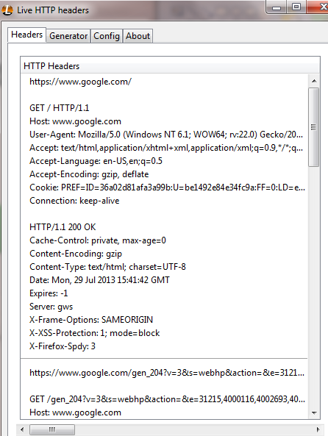
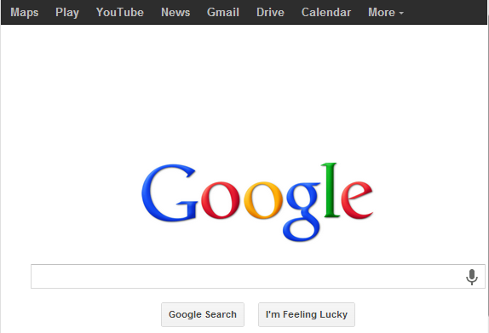
Step 7 – we see a web page!
Google sends parts of web page as packets and the browser builds those to show on the screen as the Google Home Page.
We can see the delivery of the page using a Firefox add-on called LiveHTTPHeaders

